Slide 1
Basics of Programming
Java,C#,C++,C,JavaScript,TypeScriptPython

Slide 2
Topics
Datatypes
Variables
Methods
Arithmetic Operators
Loops

Slide 3
DATA TYPES
Java
Integer …………..-5,-4,-3,-2,1,0,1,2,3,4,5……………… 45
Charcter ‘ a’,’b’,’c’,’d’,’e’,’f’,’g’,’h’
Boolean true/false
Double Ex:: amout 15000000.00
Float 89.0
String “ abhinay”
Long 99084545414

Slide 4
DATA TYPES IN TYPESCRIPT
NUMBER
BOOLEAN
STRING
DATE
NULL
VOID
UNDEFINED
<ARRAY> GENERIC

Slide 5
VOID
EMPTY RETURN WITHOUT ANY DATATYPE
VOID IS EMPTY
VOID IS APPLICABLE FOR METHODS

Slide 6
STRING
String is enclosed with double quotes “ ”
ex:: firstName:string=“Maharaj”;
firstName==>variable
string==>datatype
“maharaj” ==> value
password:string=“Maharaj@123”;

Slide 7
NUMBER
syntax:: age:number=25;
age==>variable Name
number==>Datetype
= ==>assignment operator
25 value
age:number=25;
amount:number=100000.90;
fever:number=102.90;

Slide 8
Boolean
Predefined Values
TRUE,FALSE
isDisabled:Boolean=false;
isDisabled==>variable;
Boolean==>Datatype;
False==>value

Slide 9
DATE
YYYY-MM-DD
DD-MM-YYYY
DD-MMM-YYYY
1995-09-09
09-09-1995
09-SEP-1995
dob:Date; dob==variable,Date == datatpe
dob:Date=new Date();

Slide 10
NULL
NULL==EMPTY NULL IS USED FOR FUTURE UTILIZATION
name:string=null;
name=null;
color:string=null;
getColor(){
this.color=“red”;
}

Slide 11
METHODS
1.method with return type and with parameter
2. method without return type and with parameter
3. method without return type and without parameter
4. method with return type and without parameter

Slide 12
Method with return type and with parameter
EX:: public int addTwoNumbers(int a,int b){
int z=a+b;
System.out.prinltn(“The Addition of Two numbers is ”+z);
return z;(Integer value)
}
public=keyword,int=datatype,addTwoNumbers=method,
(int a,int b)=parameters

Slide 13
Method without return type and with parameter
EX:: public void addTwoNumbers(int a,int b){
int c=a+b;
System.out.println(“The Addition of two Numbers is”+c);
}
void ==> empty return type cannot return any thing

Slide 14
Method without return type and without parameter
EX::public void addTwoNumbers(){
int a,b;
int c=a+b;
System.out.println(“The Addition of Two Numbers is”+c);
}

Slide 15
Method with return type and without parameter
Ex:: public int addTwoNumbers(){
int a,b,c;
c=a+b;
System.out.println(“The Addition of two Numbers is::”+c);
return c;
}
NOTE::IN programming return statement should be last

Slide 16
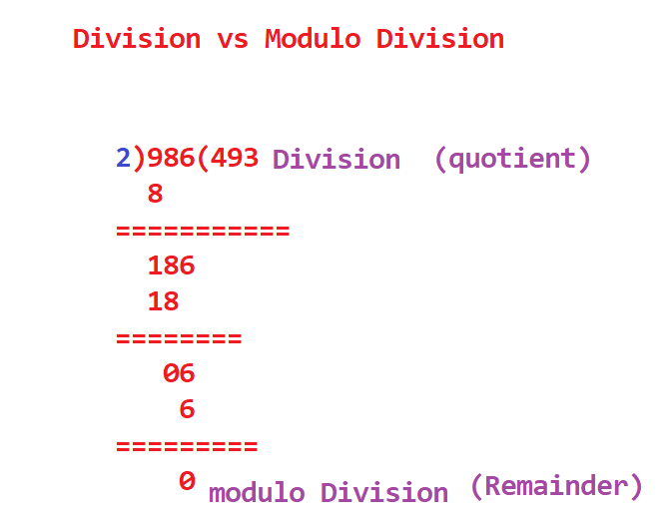
Divison vs Modulo Division

Slide 17
Variables
Static variables Without creating object we can access the variables
Instance Variables Instance varaibles are also known as class level variables
Local Variables We can local variables inside the method
Static Variables:: static int a=10;
Instance Varaibles:: int a=10;
Local varibales public void addTwoNumbers(){
int a=10;
}

Slide 18
Arithmetic Operators
Addition + EX: a+b=10+20=30
Substarction - EX:: a-b=50-40=10
Multiplication * EX::a*b=10*20=200
Division / EX::a/b=100/2=50
Modulo Division % EX::a%b=100%2=0

Slide 19
Logical Operators
&& Logical AND EX:: if(a&&b)
|| Logical OR EX:: if(a||b)
! Logical Not EX:: if(a!b)

Slide 20
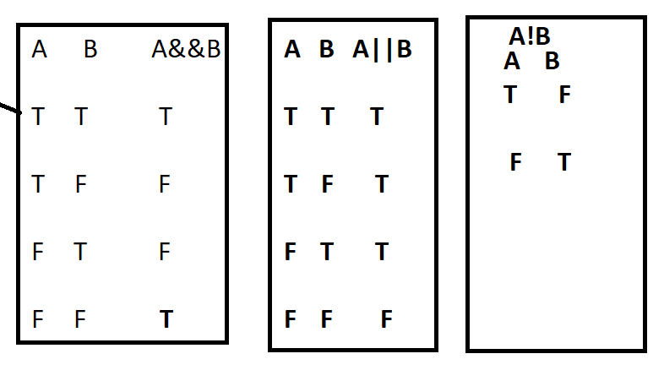
Truth tables in Programming

Slide 21
LOOPS
FOR
WHIILE
DO WHILE

Slide 22
FOR LOOP
for(i=1;i<=10;i++){
conole.log(i);
} for==keyword
i=1==initialization
i<=10 ==condition
i++/i-- == increment or decriment

Slide 23
While loop
While(<condition>){
//statements
}
If condition is true the while statements will be executed

Slide 24
Assignment Operators
= EX:: int a=10; value will be assigned
a will be 10
== EX::
if(a==b){ //checking the value
a value , b value same
}

Slide 25
DO while
do{
//statements;
}while(<condition>);
First statements will be exceuted after It checks the condition

Slide 26
Conditional Statements
If
If-else
If-else if -else
Ladder if
Nested if

Slide 27
IF Condition
If(<condition>){
//statements
}
If condition is true statements will be executed ,
If condition is false it come out

Slide 28
IF-ELSE CONDITION
If(<condition>){
//statements
}else{
//statements
}
If condition is true if block statements will be executed
If condition is false else block statements will be executed

Slide 29
If-else if -else
If(condition){
//statements
else if(condition)
//statements
}
else{
//statements
}

Slide 30
LADDER IF
If(<condition>){
//statements
}
If(<condition>){
//statements
}
If(<condition>){
//statements
}

Slide 31
Nested If
If(<condition>){
//statements
if(<condition>){
//statements
if(condition ){
//statements
}3
}2
}1

